Slide 1
Machine Learning Methods
Splitting Data into Training and Test Datasets
Cross-Validating Models for each Variable Combination
Selecting Model with Lowest Test Mean Squared Error
ML
Stage I
Run Tuned Model on Entire Dataset and Analyze Results
Tuning Selected Model Hyperparameters
ML
Stage II
Apply Importance Values to Dissect Predictive Power
Use PDP Values to Analyze Important Variable Behavior

Slide 2
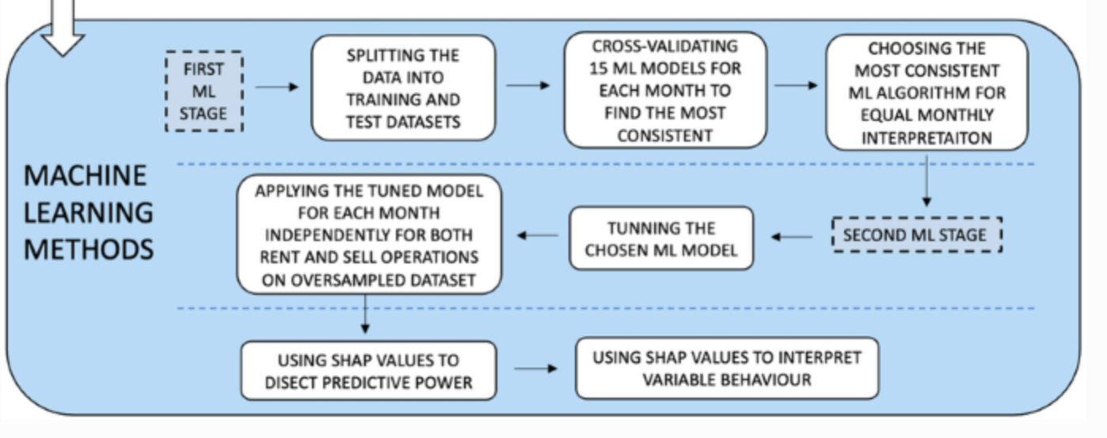

Slide 3
Validation Set Approach
Total Data Set
1, 2, 3, 4, 5, …
n
Train Data Set (80%)
Test Data Set (20%)
1, 37, 77, 2, 45, …
39, 3, 92, 13, 5, …

Slide 4
K-Fold Cross Validation
(k = 4)
Total Data Set
1, 2, 3, 4, 5, …
n
Test Data Set (25%)
1, 37, 77, …
92, 13, 5, …
1, 37, 77, …
92, 13, 5, …
1, 37, 77, …
92, 13, 5, …
1, 37, 77, …
92, 13, 5, …

Slide 5
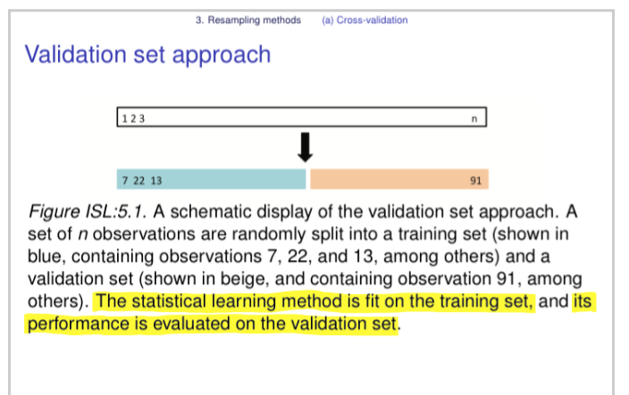
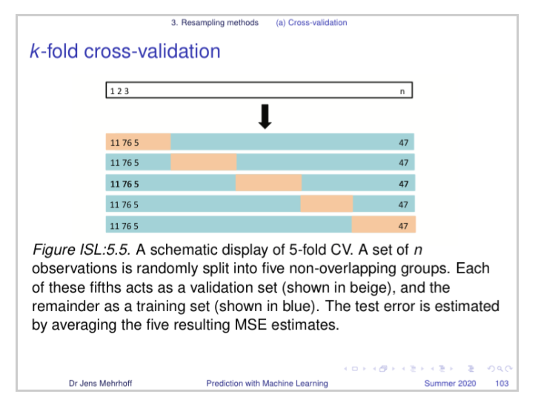

Slide 6
Unique Identifier | beds_total
#112345 | beds_total_1
#22346 | beds_total_2
#31452 | beds_total_3
#49083 | beds_total_4
#59867 | beds_total_5
Unique Identifier | beds_total_1 | beds_total_2 | beds_total_3 | beds_total_4 | beds_total_5
#112345 | 1 | 0 | 0 | 0 | 0
#22346 | 0 | 1 | 0 | 0 | 0
#31452 | 0 | 0 | 1 | 0 | 0
#49083 | 0 | 0 | 0 | 1 | 0
#59867 | 0 | 0 | 0 | 0 | 1
One-Hot Encoding

Slide 7
Results Structure
Key Variable Analysis
Number of Bedrooms
Days on the Market
Land Size
Corona Crisis
Property Style
Corona Crisis
City Limits vs Not
Price: Q1 vs Q4
Size: Q1 vs Q4
Age: Q1 vs Q4

Slide 8
Subsection Analysis
Corona Crisis
City Limits vs Not
Price: Q1 vs Q4
Size: Q1 vs Q4
Age: Q1 vs Q4
Key Variable Analysis
Number of Bedrooms
Days on the Market
Land Size
Property Style

